Slide 1
Autonomous Intersection Management
Ahmed Fayed & Alex Winger

Slide 2
Project Scope & Schedule
4-way 3-dedicated-lane intersection with a centralized architecture
Keep the number of messages/communication V2V to a minimum, for scalability purposes and respecting each vehicle’s privacy
Assumptions:
Fully autonomous vehicles (Tesla Model S), focusing less on Driver Agents and mostly on the arbiter/Intersection Manager
No communication failure or delay
No execution error
A high resource powerful computer system placed at the intersection powering the Intersection Manager (IM)
To accomplish this we will use ROS, and a visualization software

Slide 3
Progress & Challenges
Finished converting Matlab code to Python
Traffic generation, collision detection, car management
Challenges: Code was not robust and needed to be redesigned more than we expected
Developed simple visualization for testing
Implemented Dresner/Stone and stop sign policies.
Challenges: More advanced traffic light policy has taken more time to formulate

Slide 4
Changes & Measures of Success
Develop our own policy for granting reservation requests
Our system should:
Have no collisions
Decrease the average delay of vehicles passing through the intersection
Compare our policy with other traffic control policies:
Traditional traffic lights
Stop signs
Dresner and Stone policy

Slide 5
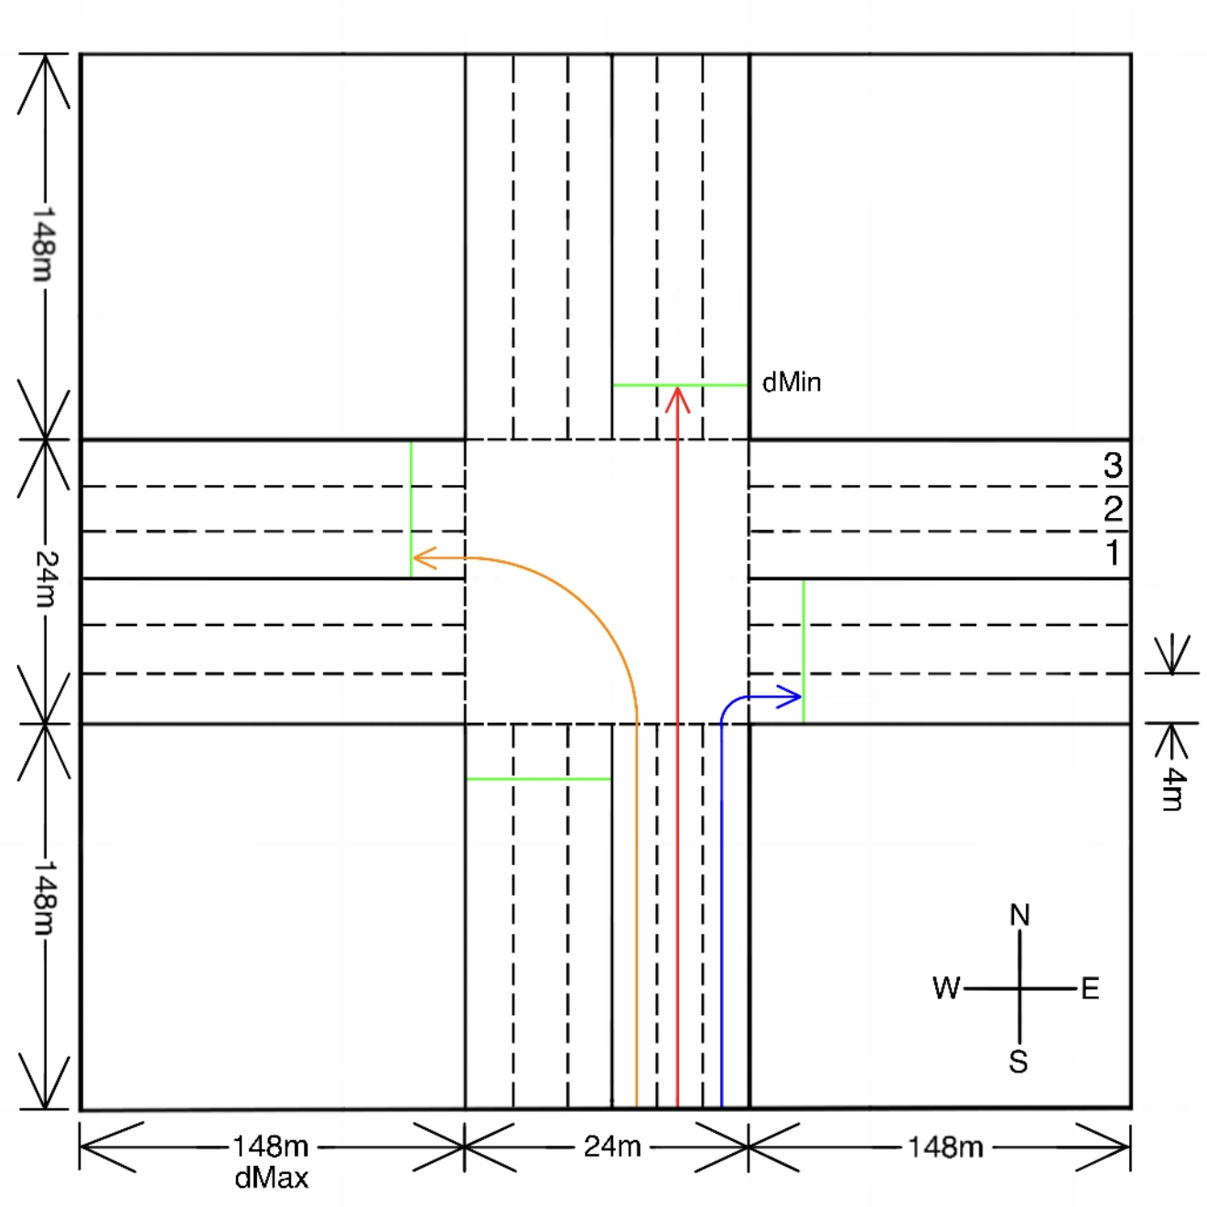
Intersection Layout

